Slide 1

Brain tumor Detection using Deep learning
Sinhgad College Of Engineering
Department Of Computer Engineering
Presentation By:
Group No : 30
Aman Yadav
Vishvesh Singh
Abhishek Tiwari
Anand Jaiswal
Guided By:
Prof. R. A. Vasmatkar

Slide 2
contents
Abstract
Introduction​
Literature Survey
​Problem Statement
Objectives
Proposed System Architecture
Methodology
Conclusion
References

Slide 3
abstRact
The anomalous development of cells in brain causes brain tumor that may lead to death.
Most common method to detect the tumor in brain is the use of Magnetic Resonance Imaging (MRI).
MR images are considered because it gives a clear structure of the tumor.
In this project we have created a machine learning model for detecting tumor from MR image by applying machine learning algorithm – Convolutional Neural Network

Slide 4
Introduction
Brain tumor signifies a malformed mass of tissue wherein the cells multiply abruptly and ceaselessly within the brain tissues
MRI is a technique used in medical imaging which is considered to be the most efficient tool to analyze the internal structures of the body.
The problem with detecting brain tumors is that tumors can vary in size, shape, appearances, location and orientation.
The accuracy of conventional MRI for diagnosing intracranial tumors is generally satisfactory(72%-75%) but it should not be too heavily relied upon, especially for certain tumor types.

Slide 5
A convolutional neural network or CNN, is a deep learning neural network designed for processing structured arrays of data such as images.
Convolutional neural networks are widely used in computer vision and have become the state of the art for many visual applications such as image classification, and have also found success in natural language processing for text classification.
We have implemented CNN in this project to detect brain tumor from MR images

Slide 6
Literature survey
Sr. No. | Authors | Publication | Description
1 | Wei Chen, Xu Qiao, Boqiang Liu, Xianying Qi, Rui Wang and Xiaoya Wang | Jul, 2018 | A novel method based on the features of separated local squares. Super pixel segmentation, feature extraction and segmentation model construction are done on this proposed method for brain tumor segmentation.
2 | Ilyasse Aboussaleh, Jamal Riffi, Adnane Mohamed Mahraz, and Hamid Tairi | Dec, 2021 | Brain Tumor Segmentation Based on Deep Learning’s Feature Representation
3 | Mircea Gurbina Mihaela Lascu Dan Lascu | Jul, 2019 | Tumor Detection and Classification of MRI Brain Image using Different Wavelet Transforms and Support Vector Machines
4 | C. Hemasundara Rao, P. V. Naganjaneyulu and K. Satya Prasad | Mar, 2021 | Brain Tumor Detection and Segmentation Using Conditional Random Field

Slide 7
Problem Statement
The brain is the most important organ in our body, as it regulates the rest of our organs. Brain disorders have been recognized as the world's second leading cause of mortality. If they are not detected early and treated appropriately. Early discovery and diagnosis of the tumor may aid and save the patient's life.
The assessments performed manually are still prone to errors and MRI is still inaccurate in detecting tumors at an early stage.
There is a need to build a robust tumor detection system that is accurate and precise.

Slide 8
objectives
To provide doctors good software to identify tumor and their causes.
Save patient’s time.
Provide a solution appropriately at early stages.
Get timely consultation.

Slide 9
Proposed system
The proposed system detects Brain tumor from the MRI images through image processing.
The user can upload the MRI image through the web application.
The model will read the image and scale the features using CNN
Then it will classify whether a tumor is present or not.

Slide 10
Proposed SysteM architecture
Image Acquisition
Preprocessing
Sampling data into
Training and testing sets
Model Evaluation
Training and Testing
Model
Model Building

Slide 11

Proposed SysteM architecture
Scaling and Normalizing
Select and upload MRI image
Applying Filters
for feature enhancement
Feed the final image to trained model
Read and store the result
Display the result

Slide 12
Software Requirements
Python libraries –
Numpy
cv2
PIL
os
Jupyter Notebook
MRI scan images to train and test the model.
Tensorflow
Keras
sklearn

Slide 13
methodology
Image acquisition
Data pre-processing
Segmentation
Feature Extraction
Results

Slide 14
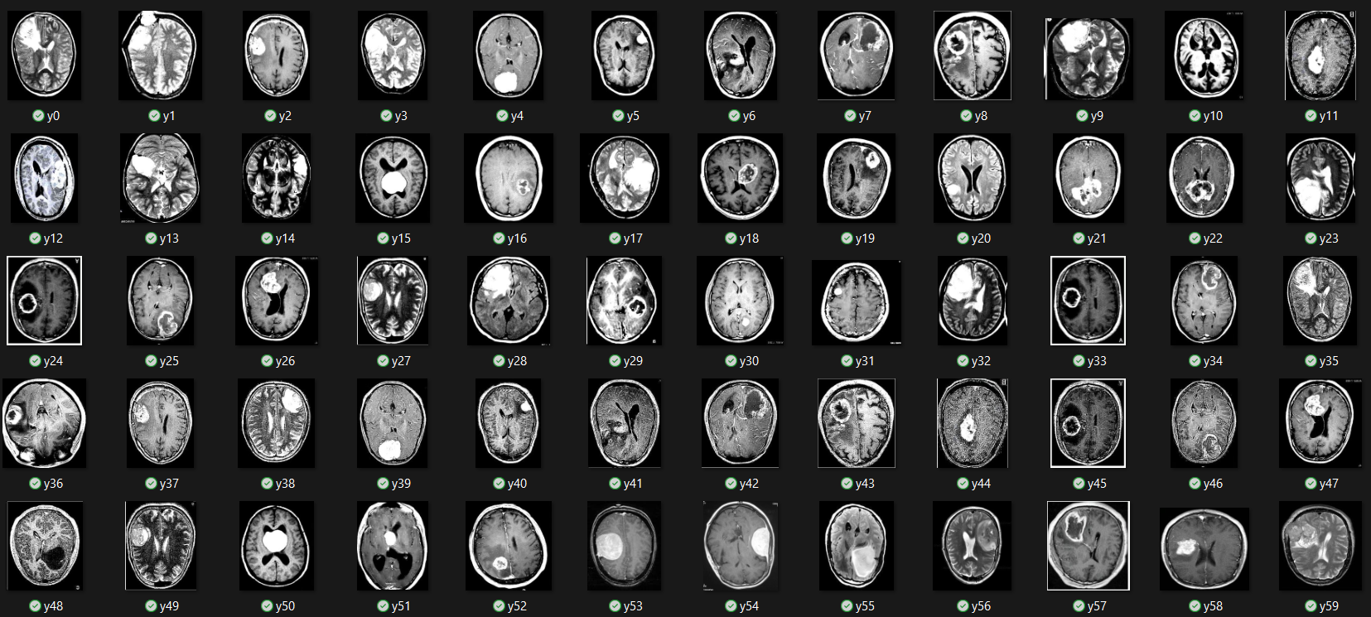
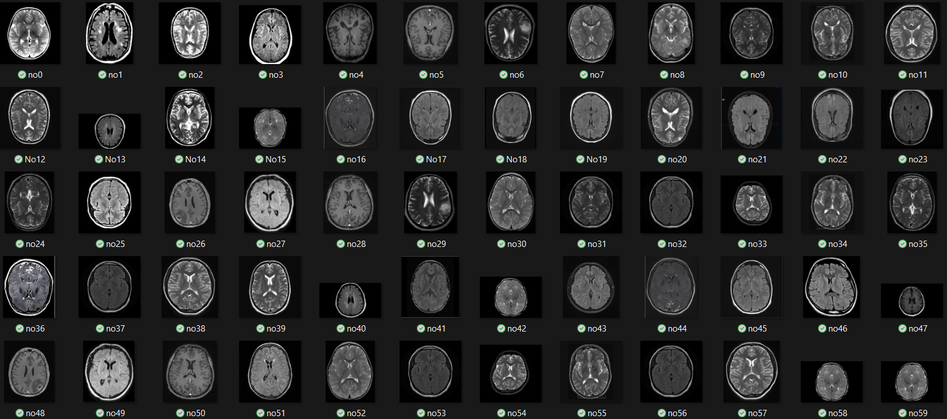
Image Acquisition
We have used Brain Tumor Detection dataset from Kaggle for training and testing the model.
This dataset contains 3000 MRI images of which 50% images contain brain tumor.
Brain Tumor present
Brain Tumor not present

Slide 15
Data Preprocessing
First, we read the images using the imread() function of cv2 library.
Using the Python imaging library, we can convert the image objects into RGB format.
As the raw images may differ in resolution, we scaled all the images to 64 X 64 px.
Then we converted all the images into numpy arrays.
Here we attach a label with each image – 1 if brain tumor is present and 0 if brain tumor is not present.

Slide 16
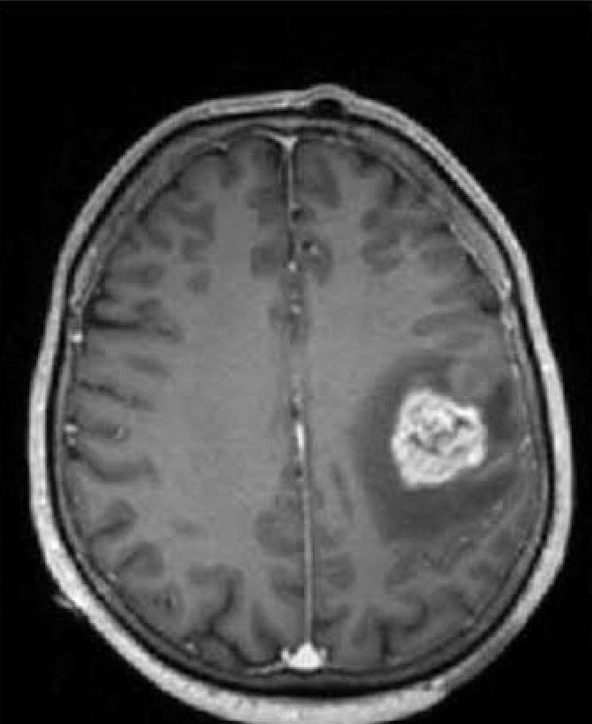
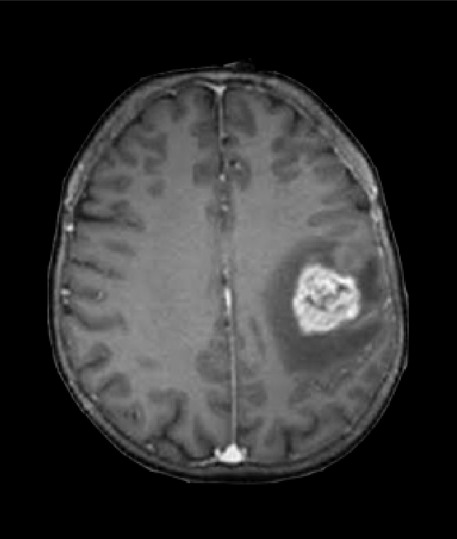
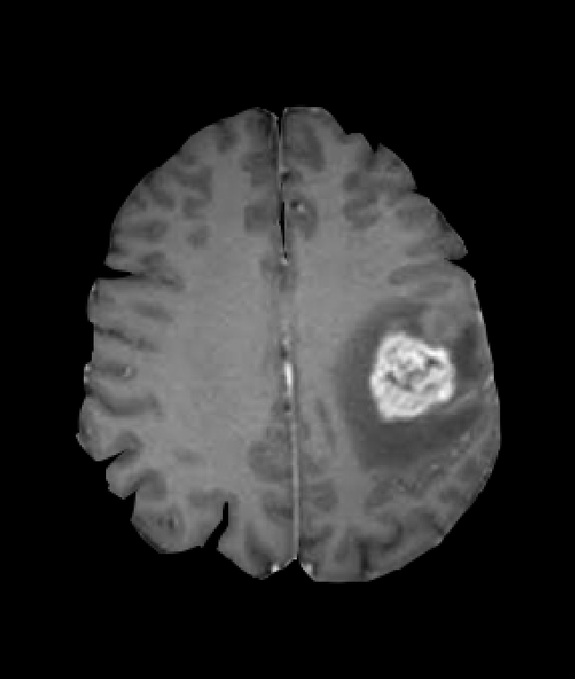
Segmentation
We add convolution layers to segment the image and to discard the unnecessary pixels.

Slide 17

Feature extraction
After applying convolution layer multiple times, only the important features are left.
Raw Image
Extracted Image

Slide 18
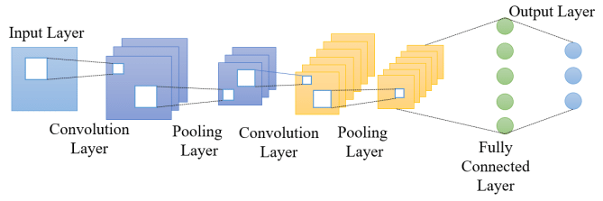
CNN Architecture
Brain tumor Detection using Deep learning

Slide 19
Results
The test accuracy of this model is 96.67%
This model accurately detects the brain tumor even it is small in size.

Slide 20
Conclusion
In brain tumor detection we have studied about image processing techniques likes image pre-processing, image segmentation, features extraction, classification and also deep learning technique- CNN
In this system we have detected that a tumor is present or not. If the tumor is present then model return’s yes otherwise it return’s no.
This system can be improved to support with a web interface. Detection of different diseases can be also identified from the MRI images.

Slide 21
References
www.kaggle.com
Avigyan Sinha, Aneesh R P, Malavika Suresh, Nitha Mohan R, Abinaya D, Ashwin G Singerji- “Brain tumor Detection Using Deep Learning” 2021 Seventh International conference on Bio Signals, Images, and Instrumentation (ICBSII)
Dr. Chinta Someswararao, R Shiva Shankar, Sangapu Venkata Appaji, VMNSSVKR Gupta- “Brain Tumor Detection Model from MR Images using Convolutional Neural Network” IEEE ICSCAN 2020
G.Hemanth1, M.Janardhan2, L.Sujihelen- “DESIGN AND IMPLEMENTING BRAIN TUMOR DETECTION USING MACHINE LEARNING APPROACH” Proceedings of the Third International Conference on Trends in Electronics and Informatics (ICOEI 2019)

Slide 22
THANK YOU

